Slide 1
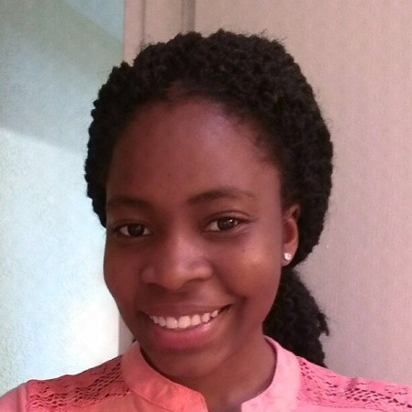
Electric Blind
Group 13
Adedoyin Adepegba – Computer and Electrical Engineering
Joshua Forrest – Electrical Engineering
Ryan Meinke – Computer Engineering
Tien Tran – Electrical Engineering

Slide 2
Project Idea
Simple Idea of automating the process of interacting with window blinds
Smart blind:
to replace conventional blinds
To provide energy saving benefits in addition to environmental advantages

Slide 3
Project Description
Motivation
Cost-efficient and energy saving product due to team member’s interests
Get teamwork experience before proceeding into workplace
Goals and Objectives
Remove conventional blinds and replace with smart ones
Meet the requirement specifications (engineering and marketing specifications)
Develop great teamwork
Produce a successful project

Slide 4
Requirement Specifications
Engineering Specifications
Power Consumption < 20 Watts
Accuracy <= 150cm
Time of Response <= 10 seconds
Idle Time <= 5 minutes
PCB Board Dimension <= 4’’ x 4’’
Activation methods
Switch
Different sensors like PIR sensor
Digital application interface

Slide 5
Requirement Specifications
Marketing Specifications
High Safety
Low Cost
High Reliability
Ease of Use
High and efficient performance
Low Power Consumption

Slide 6
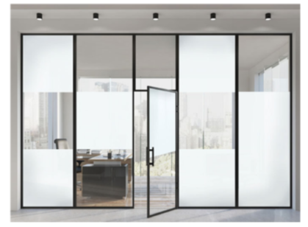
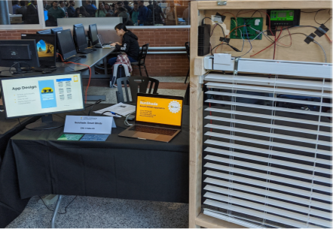
Research – Existing Projects and Products
Dream Glass (Smart Blinds)
Sunshade (SD Project 2019)

Slide 7
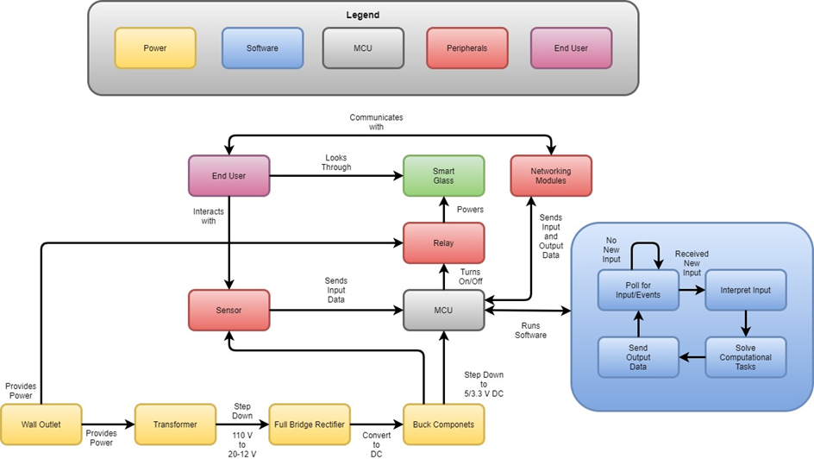
Overall Project Design

Slide 8
Microcontroller Unit Comparison Table
MICROCONTROLLER UNIT | ESP32-WROOM32 | PIC16f877A-I/P 1243J SA | MSP430G2452
Processor | Dual-core processor | 1-core processor | 1-core processor
Architecture | 32-bit RISC | 8-bit RISC | 8-bit RISC
Clock Frequency | 240MHz | 20MHz | 12kHz
Flash Memory | 4K | 8K | 8K
Operating Voltage/Power Supply | 3.0V – 3.6V | 2.0V – 5.5V | 1.8V – 3.6V
Operating Current | 80mA | 250mA – 300mA | 220uA at 1MHz
I/O Pins | 32 General Purpose I/O Pins | 5 I/O Ports | 16 capacitive-touch enabled I/O Ports
Built-in Modules/Peripherals | 2.4GHz Wi-Fi, Bluetooth BLE, SPI, DAC, I2C, Temperature Sensor, ADC, UART, USB | PWM, ADC, USART, I2C | ADC, Serial Onboarding Programming, USI supporting SPI and I2C
Integrated Development Environment | Arduino | Circuit Wizard Software | Energia

Slide 9
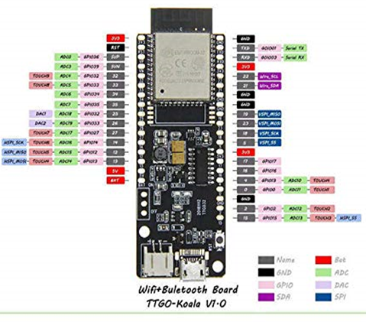
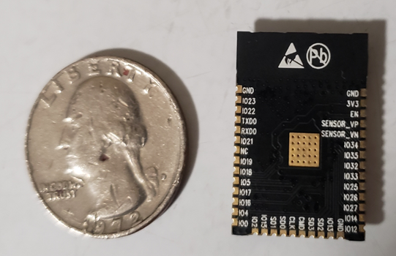
ESP32-WROOM
ESP32-WROOM Chip
TTGO-Koala with ESP32-WROOM and 4K Flash memory

Slide 10
Hardware

Slide 11
Proximity Sensing Technologies

Slide 12
 | Inductive | Capacitive | Magnetic | Ultrasonic | Photoelectric
Effective Range | 5-10 mm | 25 mm | 70 mm | 4m | 12m
Detectable | Metallic object | Metallic and non-metallic object, fluid | Metallic object | Object with simple surface | Metallic and non-metallic, object radiates wavelength
Application | Industrial | Industrial | Industrial | Industrial/Residential | Industrial/Residential

Slide 13
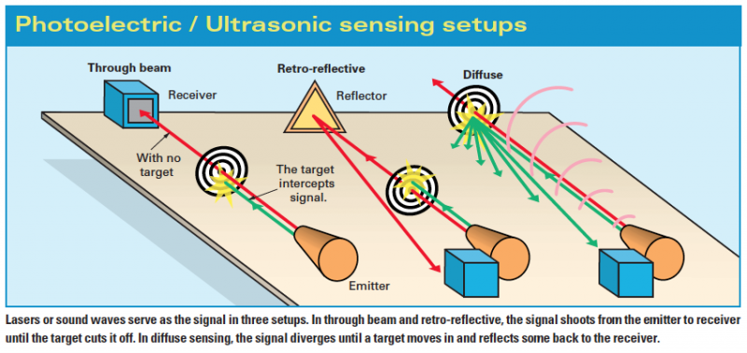
Different Modes for Photoelectric Proximity Sensing Technology

Slide 14
PIR Sensor Selections
 | Dimension (mm) | Range (m) | Input Voltage (V) | Output Voltage (V) | Price (US Dollars) | Repeatable Trigger Mode | Range and Sensitivity Adjustable
MCM 287-18001 | 24.03 x 32.34 x 24.66 | 7 | 5 - 20 | 3.3 V | 2.99 | Y | Y
HC-SR505 | 40x 10 x 13 | 3 | 4.5 - 20 | 0 - 3 | 3.23 | Y | N
Onyehn PIR | Unknown | 5 | 2.7 – 3.3 | Unknown | 4 | N | N

Slide 15
Voltage Regulator

Slide 16
 | Linear Regulator | Switching Regulator
Efficiency | Low (around 30-40%) | High (can be up to 90%)
Complexity | Low | High
Ripple/Noise | Low | High (Due to switching sequence)
Cost | Low | High
Vin Range | Narrow | Wide
Vout | Not adjustable | Wide adjustable range

Slide 17
Voltage Regulator Selections
 | XRP7659 | LM2575-ADJ
Input Range | 4.5 V – 18 V | 1.2 V – 37 V
Output Voltage | 3.3, 5, 12 V | 3.3, 5, 12 V
Output Current | 1.5 A | 1 A
Efficiency | Up to 92 % | 87.5 %
Operating Switching Frequency | 1.4 MHz | 52 kHz
Dimension | 2.82 x 2.65 x 1.45 mm (with distance between 2 pins is 0.95 mm) | 10.67 x 4.83 x 30.84 mm (with distance between 2 pins is 1.7 mm)

Slide 18
Transformer Selection

Slide 19
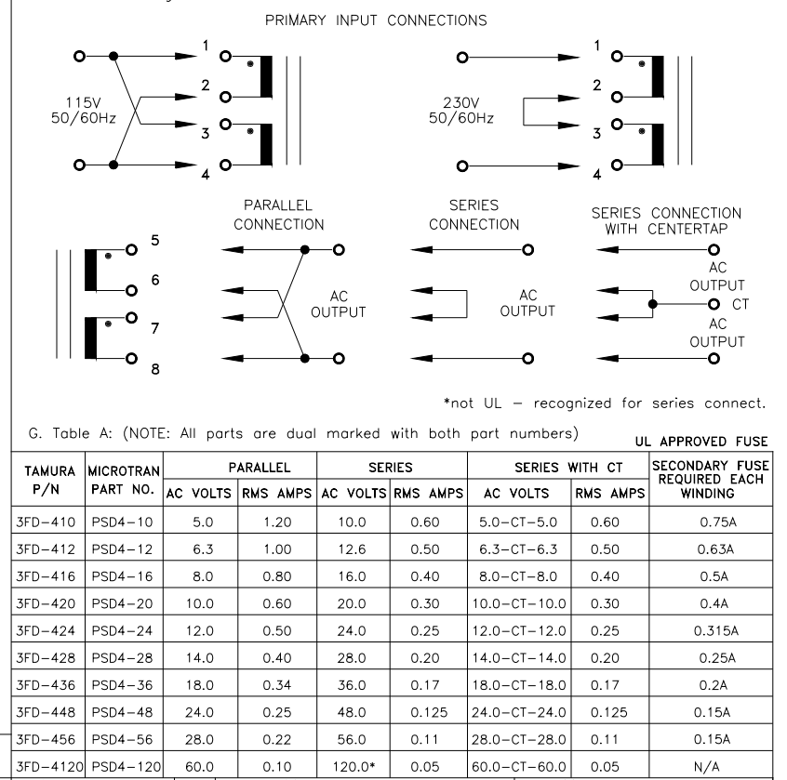
Tamura 3FD-424

Slide 20
Power Delivery

Slide 21
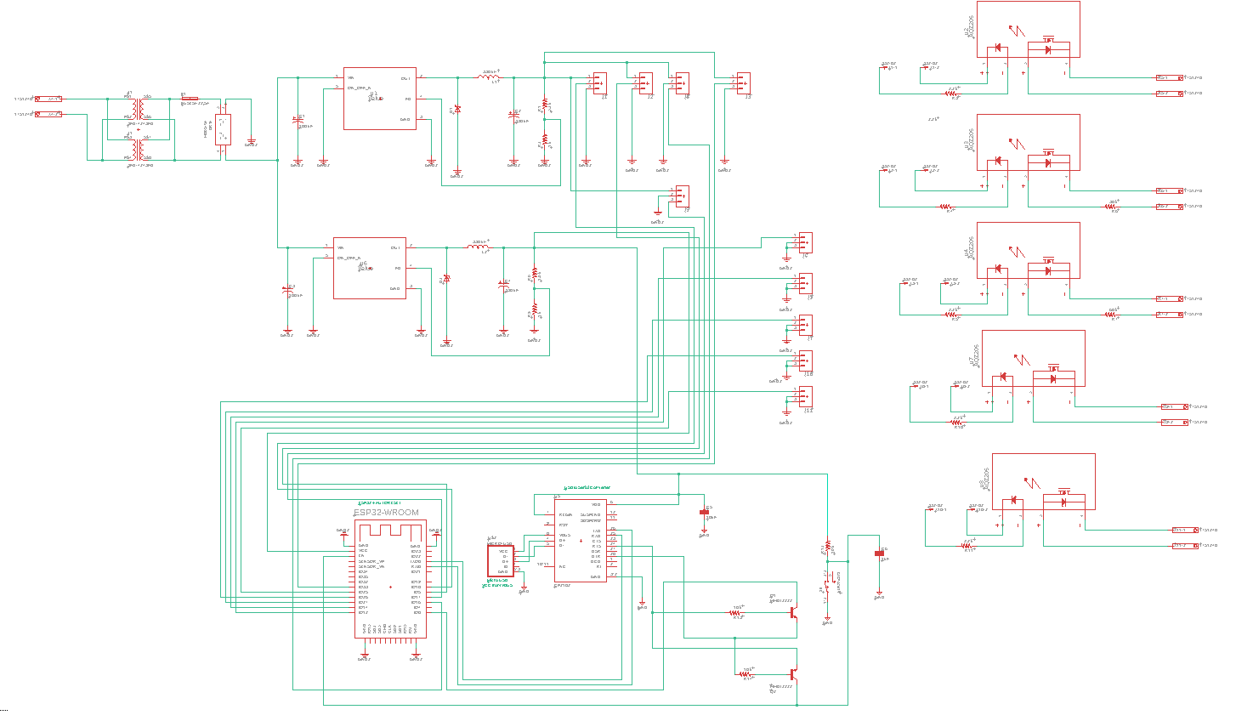
Schematic
Xformer
5V Regulator
SSR
Rectifier
3.3V Regulator

Slide 22
Power Delivery
Components | Operating Voltage (V) | Operating Current (mA) | Power Consumption (W)
PIR Sensor | 5.3 | 39.1 | 0.207
MCU | 3.3 | 250 | 0.825
Relay | 1.25 | 1.5 | 0.0019
Light Sensor | 5.3 | 34.8 | 0.184
Temperature Sensor | 5.3 | 20 | 0.106
PDLC Film | 65.6 | 0.069 | 4.5
Total Power Consumption |  |  | 5.8239

Slide 23
PCB Design
& Testing

Slide 24
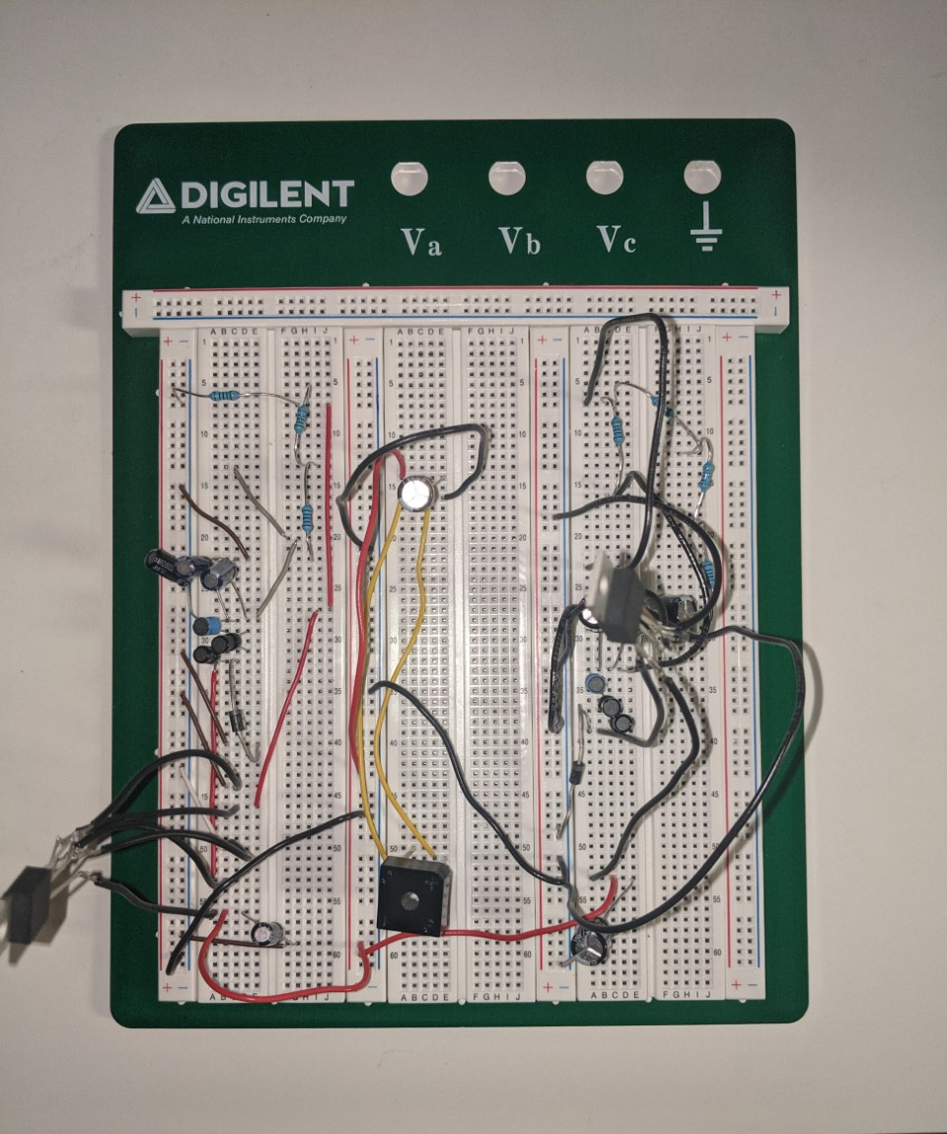
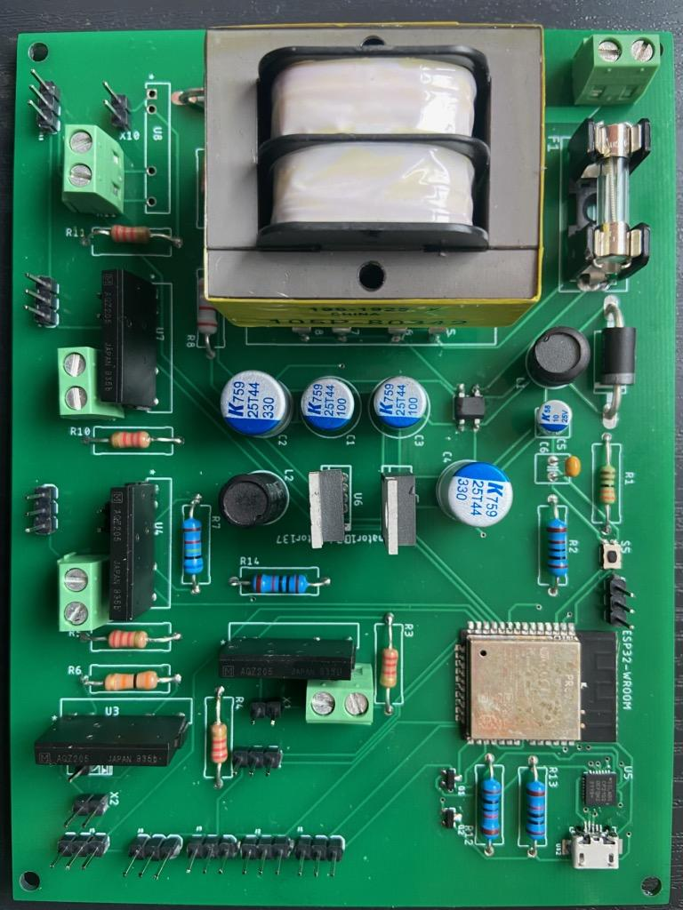
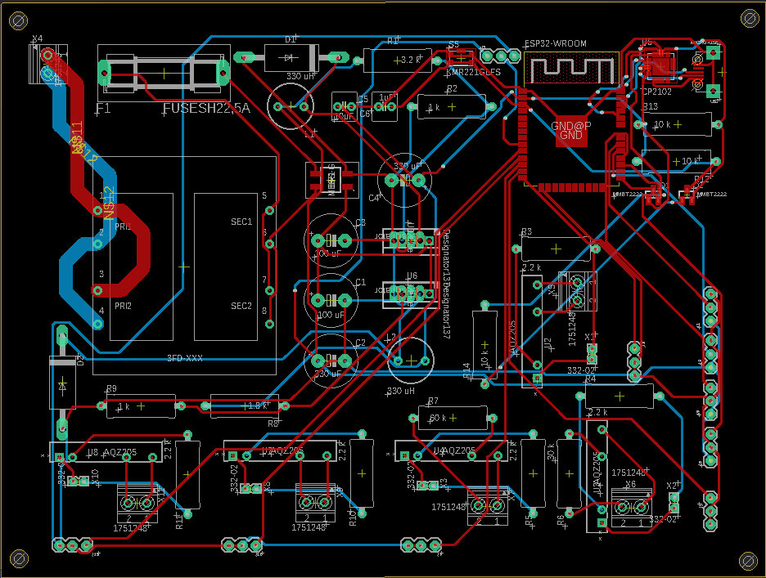
PCB Progression

Slide 25
Xformer
3.3V pins
5V Regulator
3.3V Regulator
ESP32 WROOM
SSD
5V pins

Slide 26
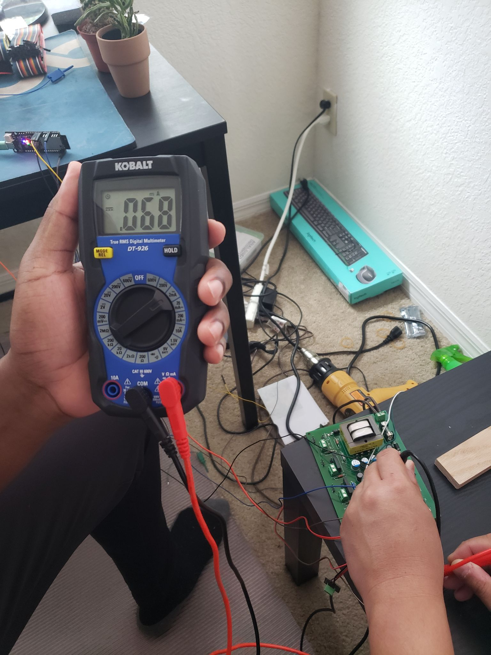
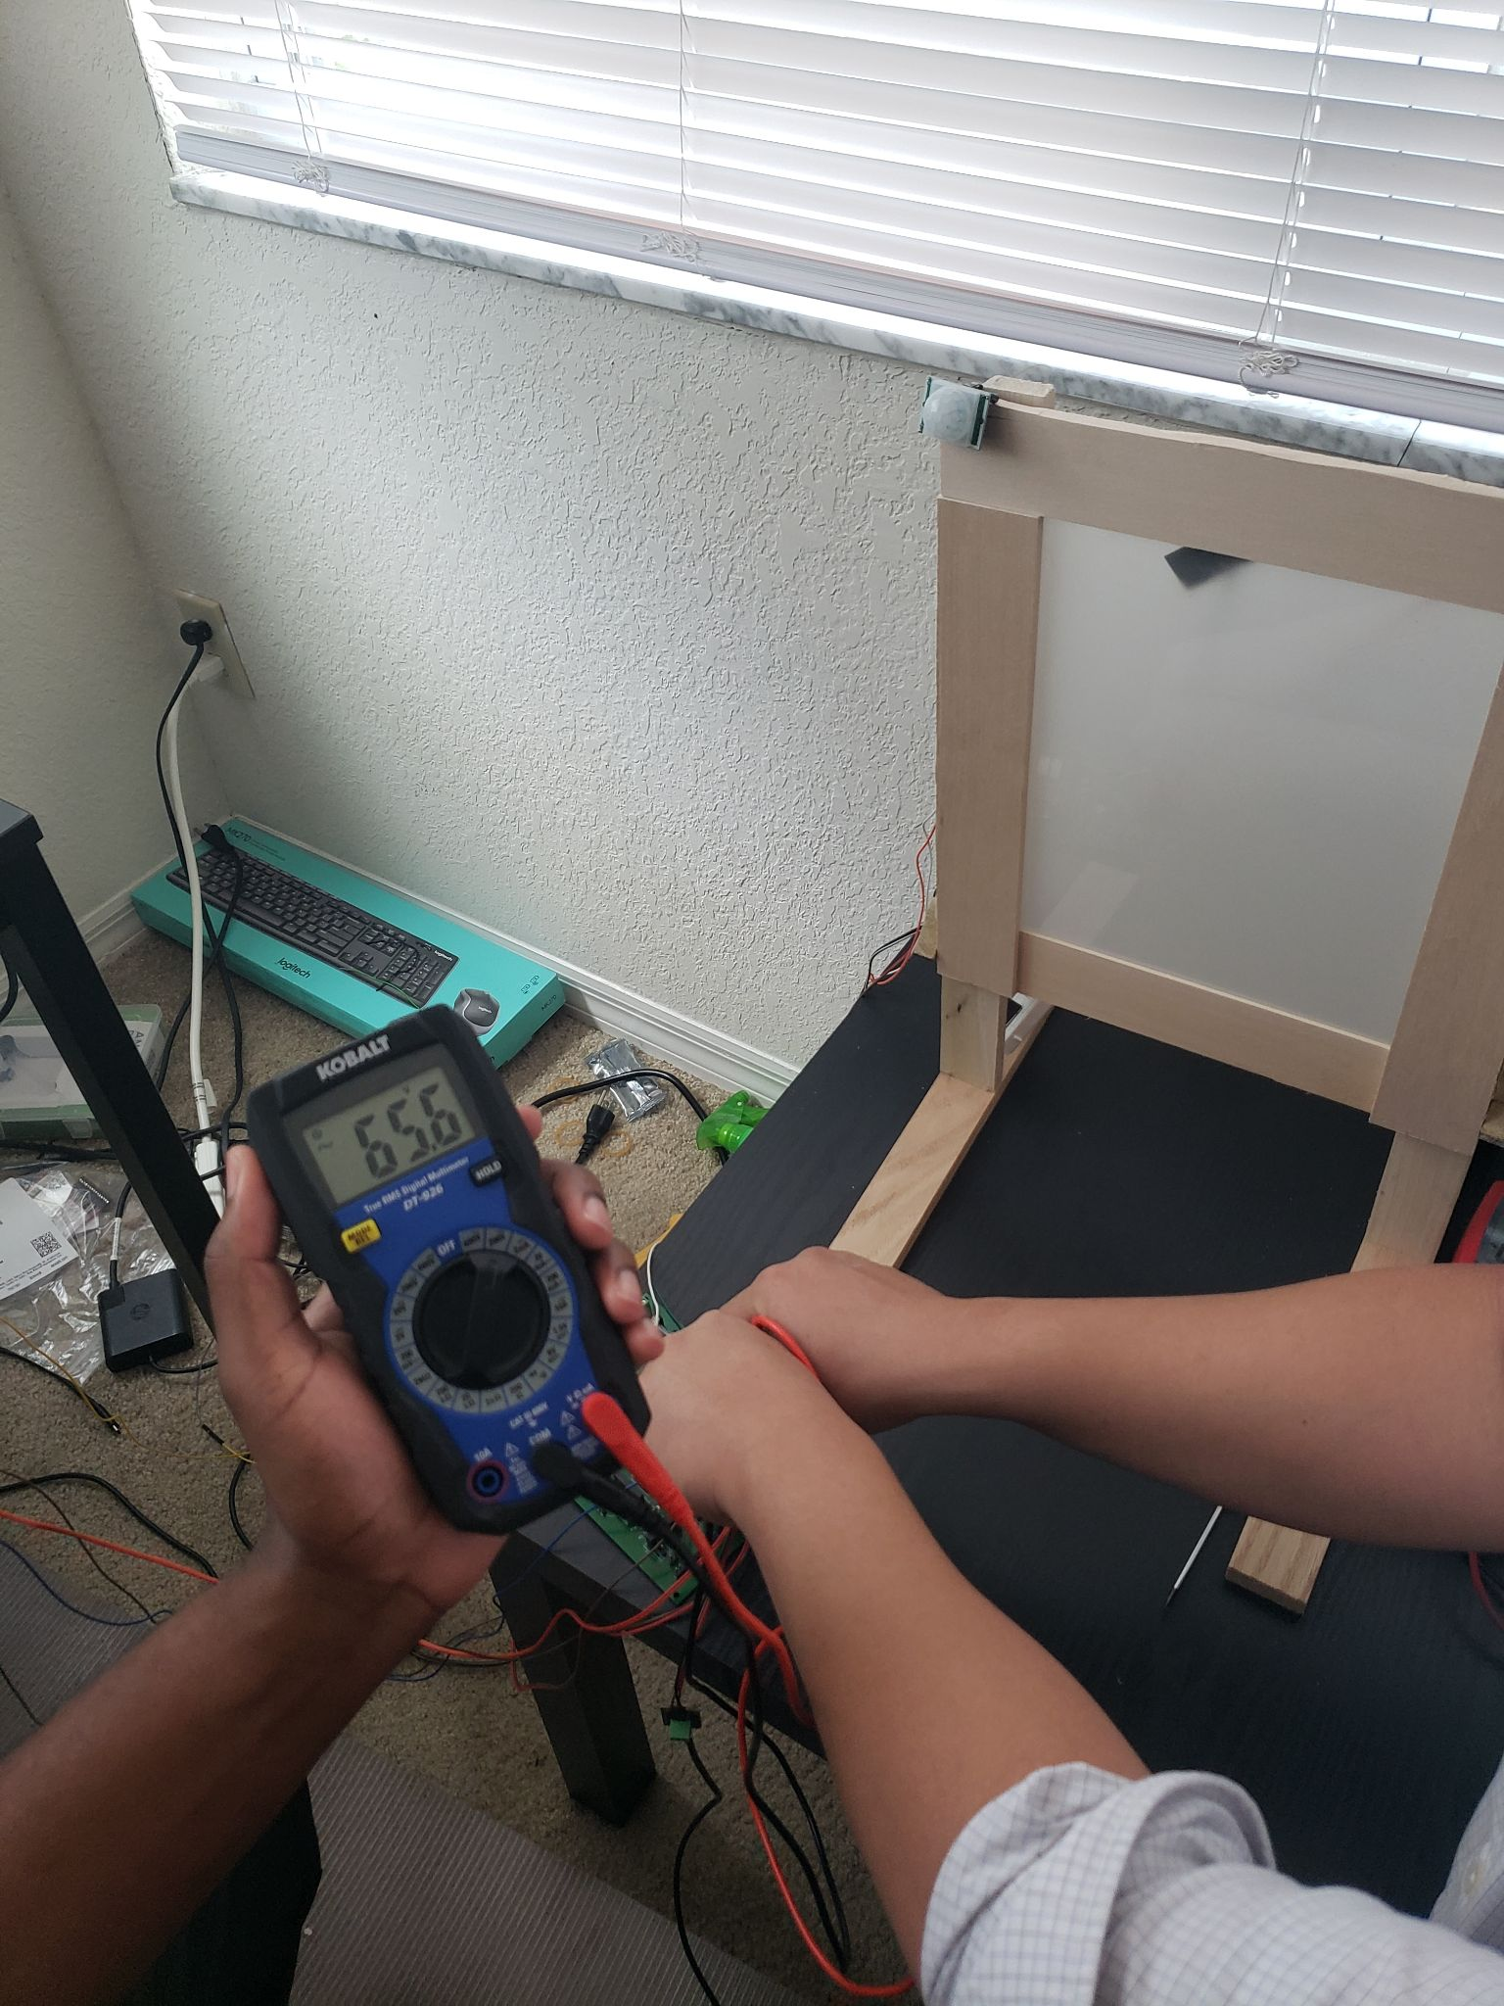
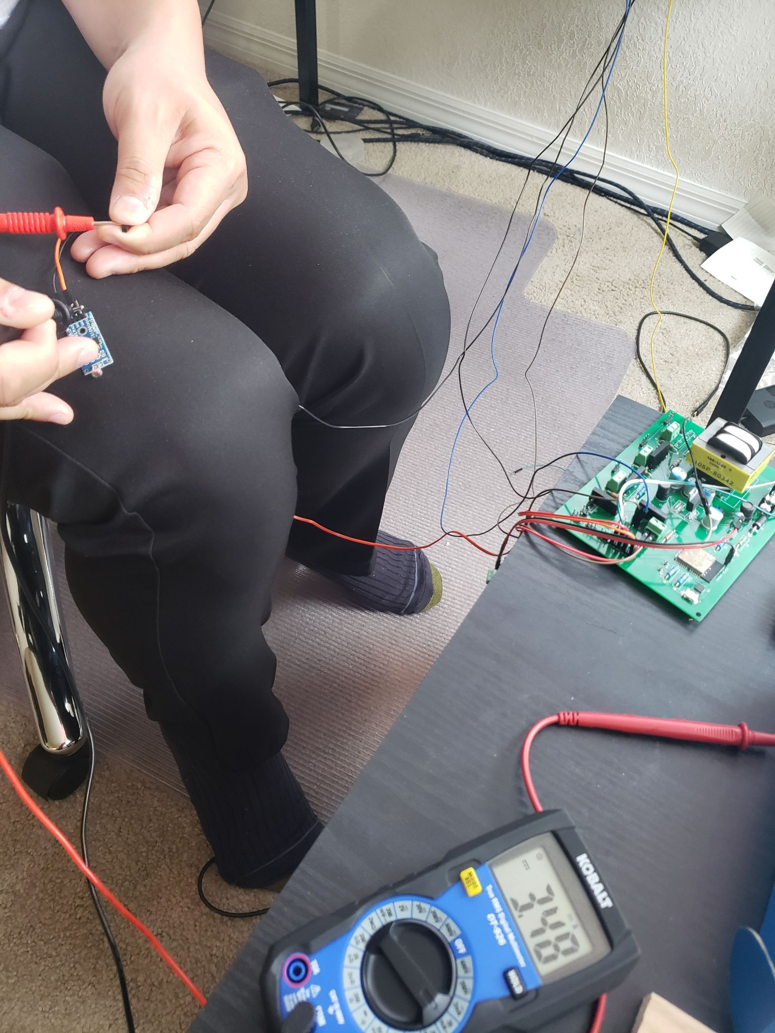
Testing
Light Sensor
PDLC
6.8 mA AC
PDLC
65.6 V AC
34.8 mA DC

Slide 27
Energy Savings

Slide 28
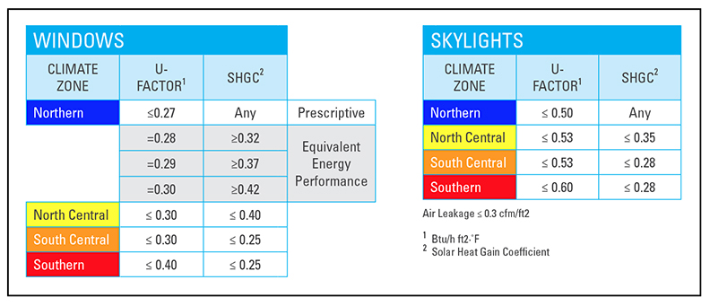
Department of energy recommendations
Our system has a SHGC of 0.1!

Slide 29
Potential Uses

Slide 30
Implementation in Residential/Corporate Spaces

Slide 31
Software
By Ryan Meinke

Slide 32
Arduino
Open Source Platform
Large Community Support
Abstraction

Slide 33
Software Jobs
Control Window State
Interpret Inputs
Provide Interfaces

Slide 34
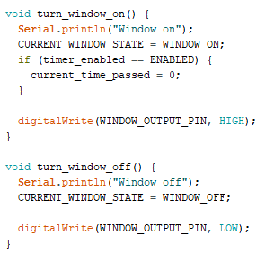
Software Job : Control Window State
Simple
on/off

Slide 35
Software Job : Interpret Inputs
Continually Check for Inputs
Two classes of Inputs
Sensors
Proximity
Light
Temperature
Network Communication
UDP on IPv4
Bluetooth
Uses Custom protocol for both

Slide 36
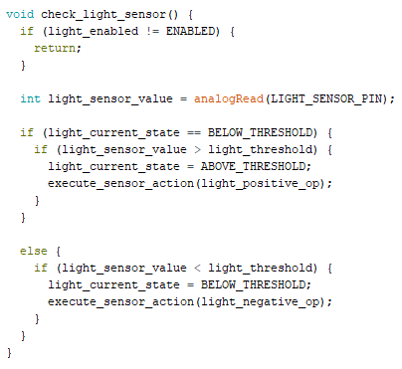
Sensors
Continually get value
Operates off a threshold

Slide 37
Sensor Threshold
Input occurs when value passes input
Two types of inputs
Value goes above threshold
Value goes below threshold
Each input has a specific action
Turn Window On
Turn Window Off
Do nothing
Threshold, actions, and enabled status configurable

Slide 38
Custom protocol Advantages
Standardized IO
Streamline Adding Functionality
Keep things clean
UDP
Multicast functionality

Slide 39
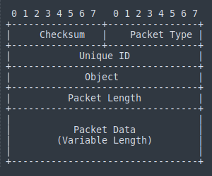
Custom protocol

Slide 40
Software Jobs : Provide Interfaces
3 Different Interfaces
Website
Computer Desktop App
Phone App

Slide 41
Website
Apache with PHP Backend
Benefits
Available to many devices
Available to many users
Drawbacks
Requires Web Server
Requires Window to be on computer network

Slide 42
Computer App
Python3
Benefits
Ease of use with computer
Drawbacks
Has to use a desktop computer
Requires Window to be on computer network
Admin Console

Slide 43
Phone App
Android app using Kotlin
Benefits
Widespread use of Android Phones
Configure Network Credentials
No Configuration needed to connect
Downsides
Physical Proximity
Must have Android Phone (can be remediated)

Slide 44
Administrative Content

Slide 45
Budget
Components | Part | Initial Budget | Quantity Used | Final Cost
MCU | ESP32-WROOM32 | 50 | 1 | 3.80
Components (Resistors, Capacitors, Schottky diode, inductors. Male pin header, jumpers etc.) |  | 70 | Multiple | 15.76
Relays | AQZ205 | 15 | 5 | 57.10
Light Sensor |  | 1.50 | 1 | 1.50
Temperature Sensor | DS18B20 | 150 | 1 | 5.99
Blind | PDLC Film | 150 | 1 | 129.67
Transformer | Tamura 3FD-424 | 10.00 | 1 | 10.00
Full Bridge Rectifier | MB8S-G | 0.325 | 2 | 0.65
Printed Circuit Board |  | 150 | 1 | 2.70
Voltage Regulator | LM2575 |  | 2 | 7.76
PIR Sensor | MCM287 | 15 | 1 | 2.99
Window Frame |  |  | 1 | 20
Total Cost |  | <$600 |  | $257.92

Slide 46
Work Distribution
Project Aspect | Power Delivery and Circuit Assembly | PCB Design and Testing | Software | Microcontroller Unit and Administrative Content
Adedoyin Adepegba |  |  |  | Primary
Joshua Forrest |  | Primary
Ryan Meinke |  |  | Primary
Tien Tran | Primary

Slide 47
Challenges
Time Constraints
Student-funded

Slide 48
Conclusion

